Slide 1
City Proper vs. Urban Area: Visualizing Global Population Density
Ean Anciso, Regi Acierto, Lance He​

Slide 2
Introduction & Objective
Goal
The Problem
Target
To analyze the relationship between city area and population for the world's largest cities.
"How big is a city?" is a hard question.
Are we counting the administrative limits (City Proper) or the continuous built-up environment (Urban Area)?
We focused on comparing major economies: China, India, and the United States, Brazil, Japan, and Indonesia

Slide 3
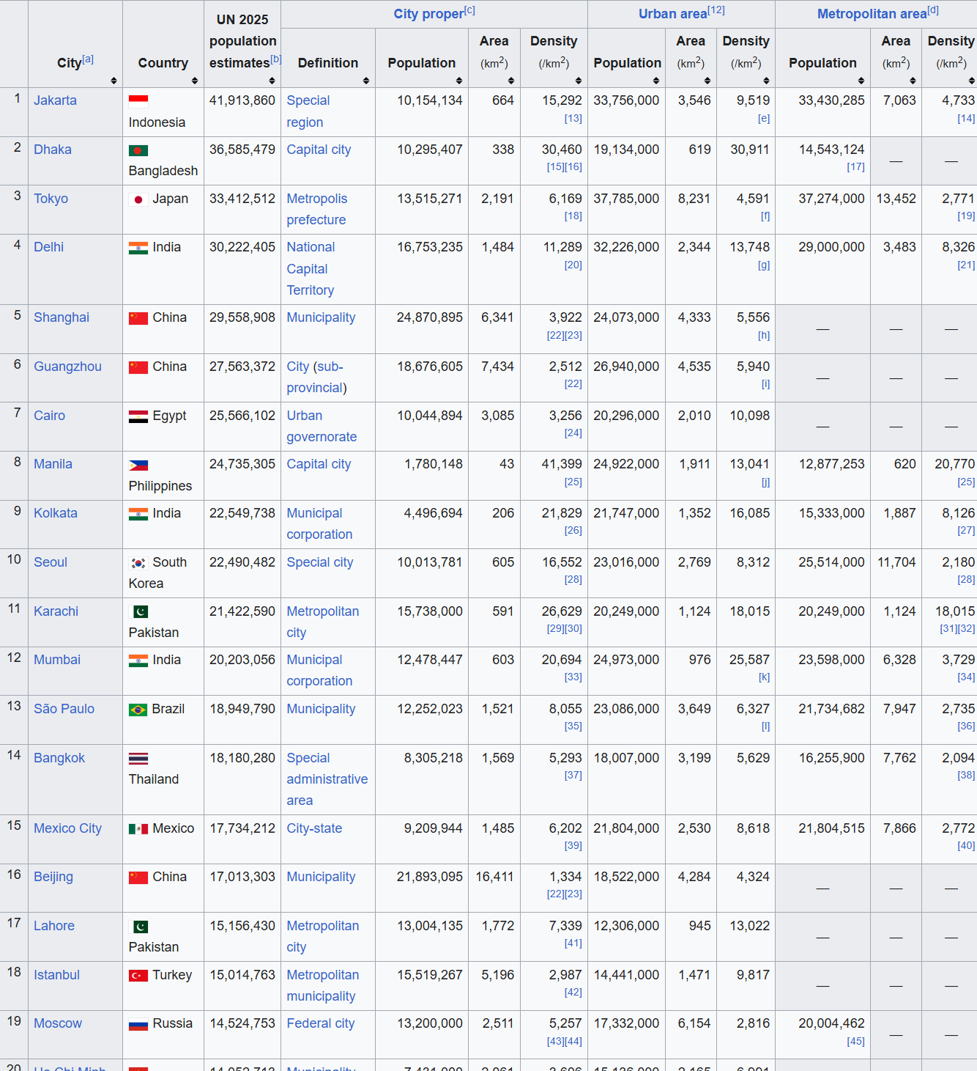
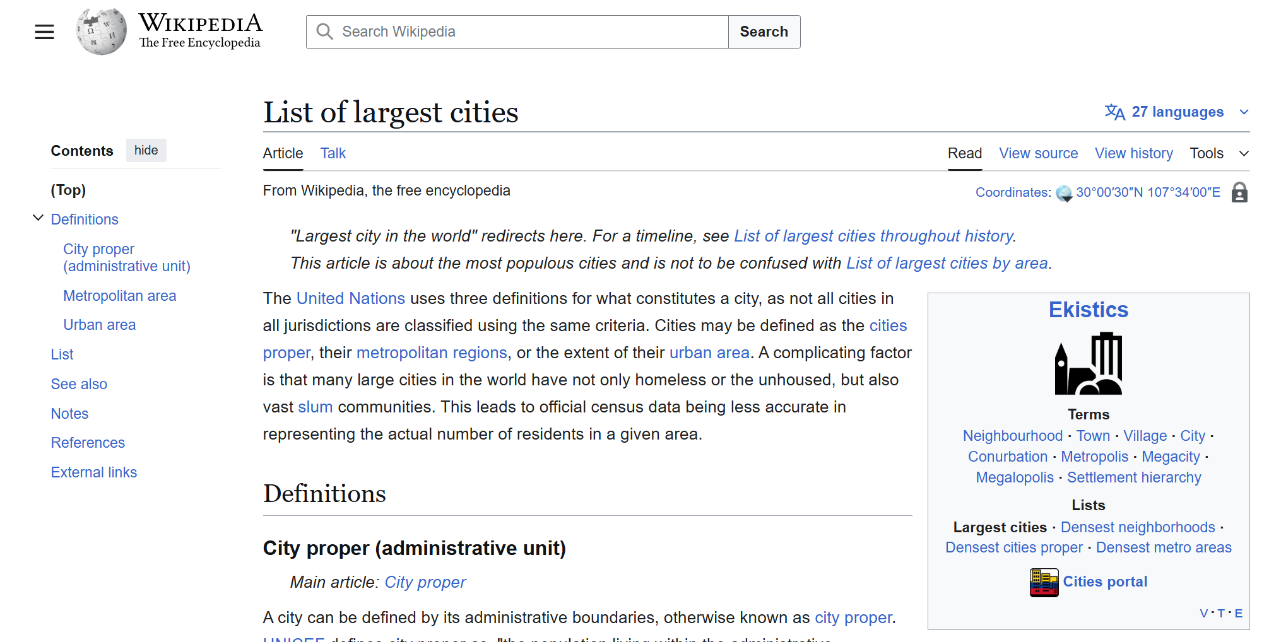
Methodology
Data Source: Scraped the "List of largest cities" from Wikipedia using the rvest library in R.
https://en.wikipedia.org/wiki/List_of_largest_cities

Slide 4
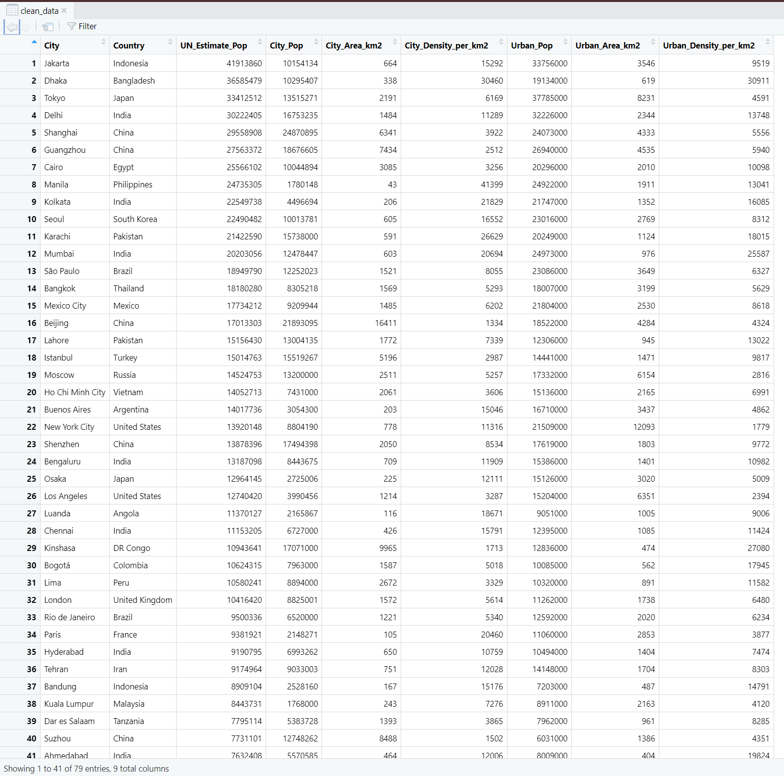
Methodology
Wrangling:
Messy Headers: The raw data had double headers (garbage rows) which we had to programmatically remove.
Inconsistent Data: Many cities were missing "Metropolitan" data, so we filtered specifically for rows that had valid "City Proper" and "Urban Area" data to maximize our sample size.
Data Types: Converted text like "10,154,134" into numeric data for analysis.

Slide 5
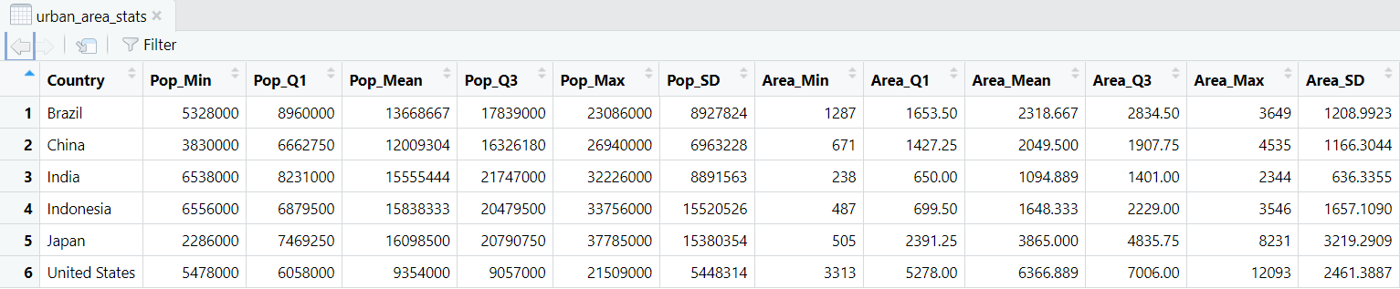
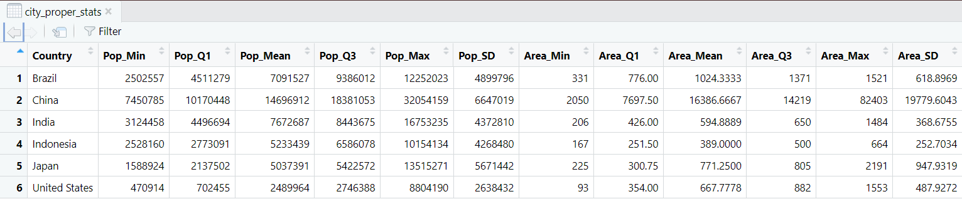
Statistical Analysis

Slide 6
Statistical Analysis
Key Insight : The "City Proper" Anomaly
Observation: You will likely see that Chinese cities have huge "City Proper" areas compared to the US or India.
In China, a 'City Proper' often includes vast rural counties (municipalities), making their areas massive. In contrast, US cities often have small administrative boundaries (e.g., San Francisco is small, but its urban area is huge).

Slide 7
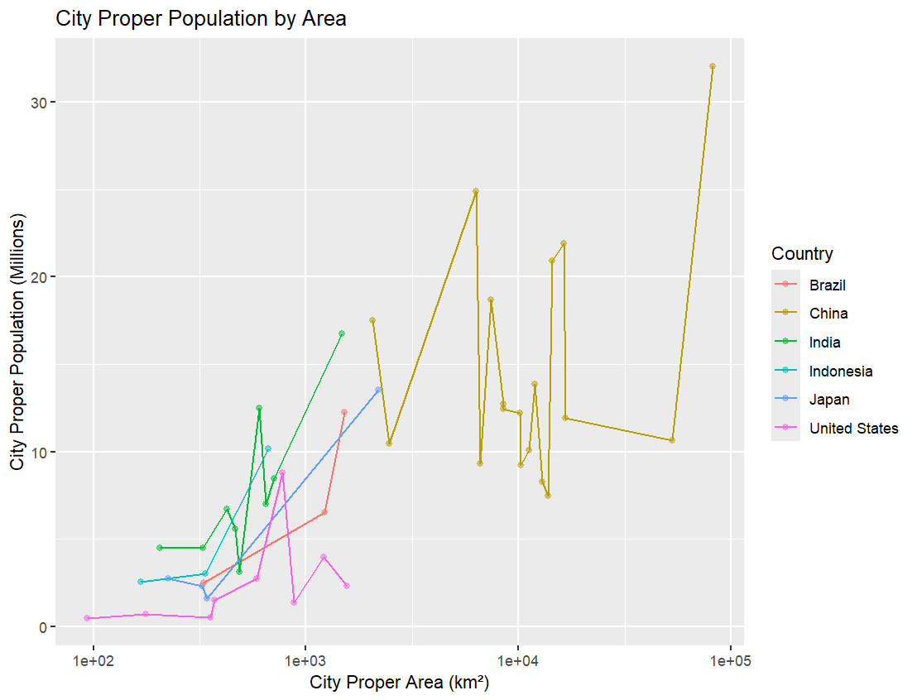
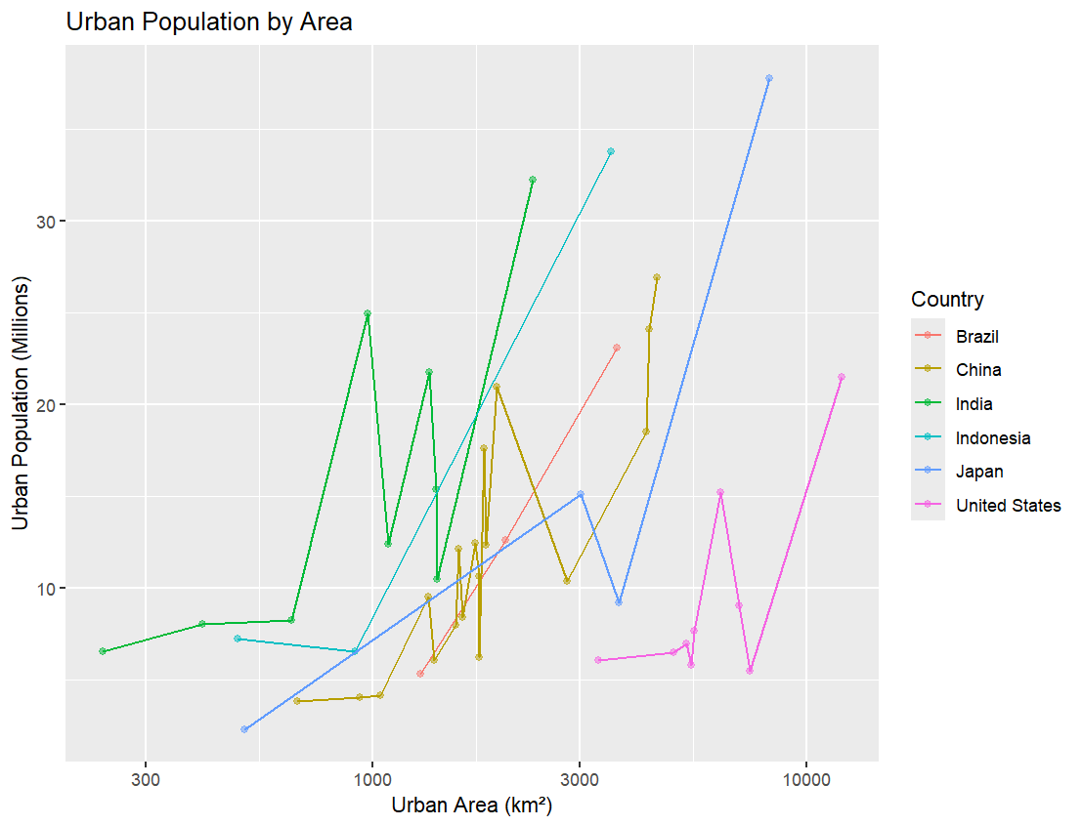
Visualizations

Slide 8
Visualizations
Why Log Scale?
We used a logarithmic scale (log10) for the axes because the difference between the smallest and largest cities is massive. A linear plot would squish most cities into a corner.
Plot A: Urban Area (Population vs. Area)
A strong positive correlation. As the built-up area grows, population grows.
Plot B: City Proper (Population vs. Area)
What to look for: This plot will be messier (more "scattered").

Slide 9
Summary and Future Plans
Summary
City Proper" is a political term; "Urban Area" is a geographical term. When comparing global urbanization, Urban Area is often the better metric because it ignores arbitrary borders.
Plans
We could expand this by scraping historical data to see how these cities have grown over time.
Build a hypothesis testing model to validate our observations

Slide 10
Challenges
Working with simple data​ makes it hard to get insightful comparisons and relationships
Using github
Finding places to work

Slide 11
Thank you!

